Slide 1
Website content
Using http://www.aeropress.co.uk as a template

Slide 2
Need a sign up log in

Slide 3
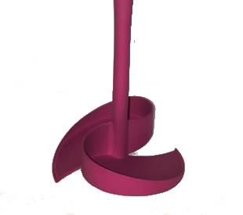

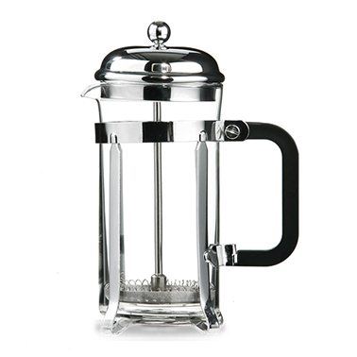
Home
The scoop with a twist
Home
Cafetiere coffee
Mess free cleaning
Block free sinks & drains
Recycle & compost
FAQs
Shop
Cleans cafetieres easily

Slide 4
Home/ scroll down
Cleans cafetieres easily
Quality coffee
Have it your way
Simplicity
Low cost

Slide 5
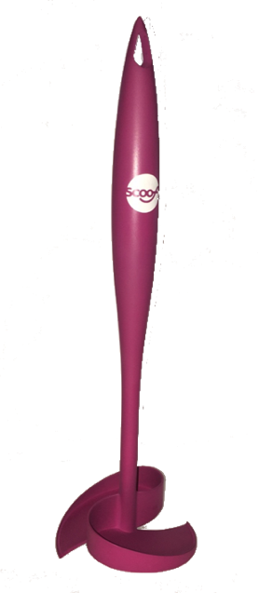
Home / scroll down
Cleans cafetieres easily
Cafetieres make high quality coffee

Slide 6
Home / scroll down
Cleans cafetieres easily
Making coffee in a cafetiere is simple

Slide 7
Home / scroll down
Cleans cafetieres easily
Make coffee your way in a cafetiere

Slide 8
Home / scroll down
Cleans cafetieres easily
A inexpensive method for great tasting coffee
1 scoop (20g) of coffee per mug
12.5 mugs in one bag of 250g premium ground coffee
I mug of black coffee 29p (price of coffee per mug)
If you paid for 12 regular Americano coffees at a high street chain - you’d be paying around £26.40
With a cafetiere you’re getting 12 mugs of black coffee for only £3.48

Slide 9
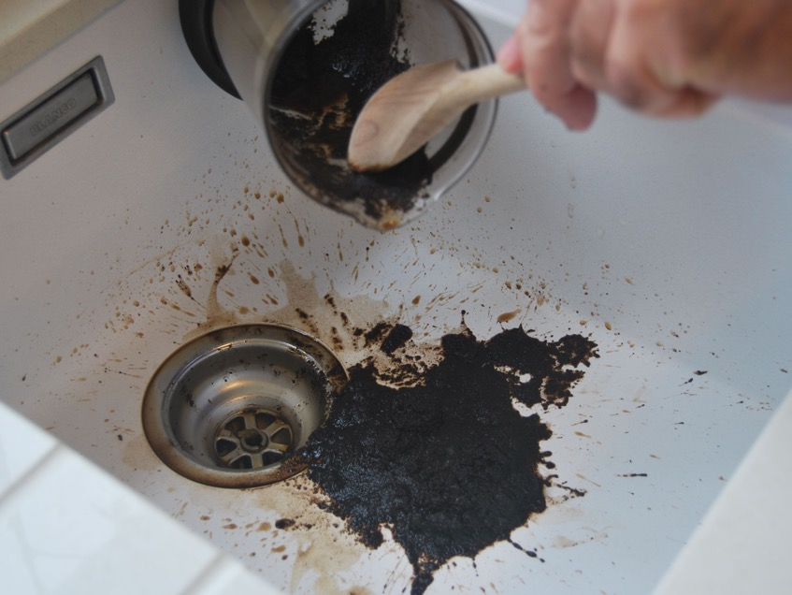
Home / scroll down
But cafetieres are a mess to clean up

Slide 10
Home / scroll down
Cleans cafetieres easily
Collects waste
No mess
No sink blockages
Saves drains and sewers

Slide 11
Cafetiere coffee
The scoop with a twist
Home
Cafetiere coffee
Mess free cleaning
Block free sinks & drains
Recycle & compost
FAQs
Shop
Cleans cafetieres easily

Slide 12
Cafetiere coffee/ scroll down
Simple – delicious coffee made to your taste
Pre-warm cafetiere with hot water.
Add 1 scoop per cup (approx. 10g) or 2 per mug (approx. 20g)
Adjust according to taste
Pour over water just before it boils. Pour slowly and wet all the grounds to ensure all the flavour infuses evenly.
Leave to stand for 3-4 minutes.
Stir with a wooden spoon for 10 seconds.
Plunge down slowly. If you come up against resistance, gently lift plunger slightly then continue to push down.
Leave for a few seconds to stand, then pour and enjoy immediately.

Slide 13
Cafetiere coffee/ scroll down
Cafetiere AKA
Koffiekan
French Press
Kaffeebereiter
Caffettiera
Cafetiere a Piston
Кофейник
Coffee Press
Coffee Plunger
Coffee Maker

Slide 14
Cafetiere coffee/ scroll down
Come in different sizes
’Standard’ 8 cup,
Measured in small espresso cups
Makes 1 litre/ fl oz of coffee
Plunger diameter is 9cm

Slide 15
Cafetiere coffee/ scroll down
Come in different sizes
4 an 6 cup,
Measured in small espresso cups
Makes 400ml/ 800ml of coffee
Plunger diameter is 9cm

Slide 16
Cafetiere coffee/ scroll down
Come in different sizes
Large 12 cup
Measured in small espresso cups
Makes 1.2 litre/ fl oz of coffee
Plunger diameter is 12cm

Slide 17
Cafetiere coffee/ scroll down
Come in different sizes
Small 3 cup
Measured in small espresso cups
Makes 0.3 litre/ fl oz of coffee
Plunger diameter is 7cm

Slide 18
Cafetiere coffee/ scroll down
Lots of different materials and styles
Borosilicate glass
Ceramic
Steel
Double walled

Slide 19
Cafetiere coffee/ scroll down
But all are esigned around a cylinder and plunger in 3 key diameters
3 espresso cup / 350 ml/ ½ pt Scoof does not fit
4 cup / 650ml/ 23 fl oz
6 cup / 850ml/ 30 fl oz
8 cup / 1L/ 35 fl oz
12/ cup /1.5L / 53 fl oz (can use scoof, no problem)
Fits
New Scoof sizes to follow . . .

Slide 20
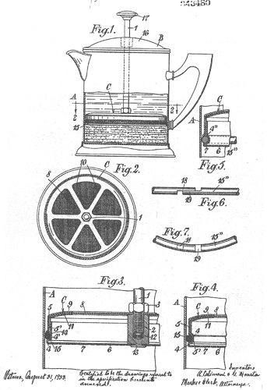
Cafetiere coffee/ scroll down
Did you know?
The first cafetière à Piston appeared in France in the 1850’s
In 1929 Italian Attilio Calimani registered the design
In the 1960’s Household Articles Ltd introduced it to the UK
Now coffee lovers enjoy cafetiere coffee all around the world
Calimani's patent drawings, 1929

Slide 21
Cafetiere coffee
The scoop with a twist
Home
Cafetiere coffee
Mess free cleaning
Block free sinks & drains
Recycle & compost
FAQs
Shop
Cleans cafetieres easily

Slide 22
Mess free cleaning/ scroll down
Wouldn’t cafetiere coffee be great without the mess?
Scoof is a dedicated utensil designed to clean cafetires. It has two blades that scoop and clean out the used coffee grounds in a simple twist
The grounds can be tapped in the food bin or used as compost

Slide 23
Mess free cleaning/ scroll down
Scoof brings ease and simplicity to cleaning cafetieres allowing you to enjoy great tasting coffee with no messy clean up
Pour off excess liquid
Insert Scoof and twist
Lift out grounds
Tap into bin

Slide 24
Block free sinks & drains
The scoop with a twist
Home
Cafetiere coffee
Mess free cleaning
Block free sinks & drains
Recycle & compost
FAQs
Shop
Cleans cafetieres easily

Slide 25
Block free sinks & drains /scroll down
Despite the old wives’ tale that coffee grounds down the sink each day is “good” for the plumbing . . .
Plumbers will tell you that nothing causes more blockages and clogged pipes than coffee grounds and grease.

Slide 26
Block free sinks & drains /scroll down
Water companies advise that sinks and toilets are kept clear of solid waste
https://www.thameswater.co.uk/sitecore/content/Bin-it/Bin-it

Slide 27
Recycle & compost
The scoop with a twist
Home
Cafetiere coffee
Mess free cleaning
Block free sinks & drains
Recycle & compost
FAQs
Shop
Cleans cafetieres easily

Slide 28
Recycle & compost / Scroll down
Coffee grounds can be collected and used as nitrogen rich compost. Once the grounds have been steeped in hot water they are washed and become pH neutral and suitable for the garden or plants. Posted on: http://.gardenweb.com
First of all, coffee grounds are a very good addition to your composting efforts. They would be considered a "green" or nitrogen source.

Slide 29
Recycle & compost / Scroll down
Some people even collect coffee grounds to grow mushrooms. Posted on: http://.growveg.com
This is where coffee comes in. The beauty of growing mushrooms on fresh coffee waste is that the substrate is already pasteurised by the coffee brewing process, so you can bypass the whole pasteurising step and get straight into the inoculating. Plus, spent coffee grounds are a huge waste resource, and are packed full of nutrients, which your Oyster Mushrooms love to grow on.

Slide 30
FAQs
The scoop with a twist
Home
Cafetiere coffee
Mess free cleaning
Block free sinks & drains
Recycle & compost
FAQs
Shop
Cleans cafetieres easily

Slide 31
FAQs / Scroll down
If you have a question that hasn't been answered, please contact us
What is the Warranty on the Scoof?
The AeroPress coffee maker is warranted against defects in materials and workmanship for a period of one year from date of purchase from an authorized retailer. We advise you to keep your receipt so that if you have a problem with your AeroPress before one year has passed, you can prove when you purchased it and that you purchased it from an authorized retailer that sells genuine AeroPress coffee makers. Authorized retailers are the ones found here.
What material do you use for Scoof?
It is a medical grade thermoplastic elastomer that we buy from a supplier for medical syringes. The chemical name is styrene-ethylene-butadiene-styrene. It is made in the USA and is FDA and EU approved for use in contact with food.

Slide 32
FAQs / Scroll down
My Scoof is becoming discoloured, what can I do to fix this?
Some people have solved this issue by simply putting the bung through a dishwasher cycle, AeroPress themselves recommend taking the following steps:1. Remove the seal from the end of the plunger.
The waste coffee is slipping off the Scoof, how do I fix this?
The amount of water that seeps through depends on the grind of your coffee, a coarse grind will allow water to pass through easier than a fine grind.1 solution is to stir quickly (8-12 sec) before inserting the plunger into the chamber, once inserted air pressure will stop the dripping and you are able to hold the brew for the desired time. Another solution would be to use the inverted brewing method.
Does the AeroPress contain BPA?
No. The AeroPress has always been free of phthalates and has been free of BPA since August of 2009.

Slide 33
FAQs / Scroll down
What Material is Scoof made out of ?
In the summer of 2014 we switched to making the chamber and plunger out of polypropylene. This means that all of the AeroPress parts except the rubber like seal are now made of polypropylene. We made the change because tests indicated the polypropylene is more durable. We regret the polypropylene is less transparent but feel the additional durability is more important. All materials used in the AeroPress are made in the USA and are FDA and EU approved for use in contact with food.
What grind should I use?
Use fine drip or espresso grind. Espresso grind takes longer to press and requires skill and patience for multiple scoops but makes a richer brew more quickly due to more particle surface area.

Slide 34
FAQs / Scroll down
What Material is Scoof made out of ?
In the summer of 2014 we switched to making the chamber and plunger out of polypropylene. This means that all of the AeroPress parts except the rubber like seal are now made of polypropylene. We made the change because tests indicated the polypropylene is more durable. We regret the polypropylene is less transparent but feel the additional durability is more important. All materials used in the AeroPress are made in the USA and are FDA and EU approved for use in contact with food.
What grind should I use?
Use fine drip or espresso grind. Espresso grind takes longer to press and requires skill and patience for multiple scoops but makes a richer brew more quickly due to more particle surface area.

Slide 35
FAQs / Scroll down
How much coffee does the AeroPress scoop hold?
A level scoop holds 11.5 grams of coffee or about 2.5 tablespoons. A heaping (rounded) scoop of coffee holds 14 grams or 3 tablespoons.
Can I damage my scoof when putting it into hot coffee?
People who want their coffee really hot enjoy it at about 145°F (63°C). If your coffee is not hot enough, preheat your mug with hot water for a few minutes prior to pressing.
How do I make a cappuccino?
A cappuccino is made up of equal parts espresso, hot milk, and foamed milk. The traditional way of foaming and heating milk is with steam. But those who have tried battery powered stirrers agree that they do a great job of foaming milk and are very easy to use and clean.

Slide 36
FAQs / Scroll down
How do I make a latte?
A latte is espresso mixed with hot milk. You can add hot milk to espresso style coffee or you can add cold milk and then heat the latte.
Can I make a real espresso in a cafetiere?
Many people say that espresso must be made with 9 bars of pressure. If you use this definition then no, the AeroPress does not make espresso. But if you define espresso by the taste of the drink in the cup, certainly many people think the AeroPress can brew espresso. Since AeroPress brewed coffee can be made into lattes, cappuccinos, and other espresso based drinks, we feel it is important to use the term “espresso” when describing what the AeroPress brews so potential customers will understand how AeroPress brew can be enjoyed.

Slide 37
FAQs / Scroll down
Can I brew tea in a cafetiere?
Yes, using the inverted method. Insert the plunger an inch or so into the chamber and then set the AeroPress on a counter with the plunger down. Put the tea into the chamber, pour hot water into the chamber, and let it steep. When ready, put a filter into the filter cap, screw the cap onto the chamber, carefully invert it onto your mug, and press. Be advised that using the inverted method may increase the risk of spilling hot water and the risks associated therewith.
How do I know that Scoof will fit my cafetiere?
We don’t currently make a larger AeroPress. But if you do two or three 3-scoop pressings into an 8 or 12 cup vacuum pot and then top off the pot with hot water, you will have enough American style coffee to serve a small gathering in less time than it takes to brew a pot of drip coffee.

Slide 38
FAQs / Scroll down
Do you make a larger Scoof for when I want to brew a 12 cup cafetiere of coffee?
We don’t currently make a larger AeroPress. But if you do two or three 3-scoop pressings into an 8 or 12 cup vacuum pot and then top off the pot with hot water, you will have enough American style coffee to serve a small gathering in less time than it takes to brew a pot of drip coffee.
Do you make a smaller Scoof for when I want to brew a 3 cup cafetiere of coffee?
We don’t currently make a larger AeroPress. But if you do two or three 3-scoop pressings into an 8 or 12 cup vacuum pot and then top off the pot with hot water, you will have enough American style coffee to serve a small gathering in less time than it takes to brew a pot of drip coffee.

Slide 39
FAQs / Scroll down
Can I compost used coffee grounds?
Yes. Once you are finished with making coffee simply eject the puck of grounds and filter into your compost bin.
Can I recycle Scoof?
Yes. Some people reuse AeroPress filters dozens of times. When finished with a pressing, peel off the filter from the puck of coffee, rinse it, and place it in the filter cap to dry in position for use with the next pressing.

Slide 40
FAQs
The scoop with a twist
Home
Cafetiere coffee
Mess free cleaning
Block free sinks & drains
Recycle & compost
FAQs
Shop
Cleans cafetieres easily

